Slide 1
Notification Service with Kafka Data Streaming
Using Spring boot

Slide 2
Technology Used
React js (Frontend)
Spring boot (Backend)
MySQL (Database)
Apache Kafka (Message Streaming)

Slide 3
Platforms
Sending Emails (Sendinblue Transaction Emails)
Kafka (provided by Confluent Cloud)
Database (freesqldatabase)

Slide 4
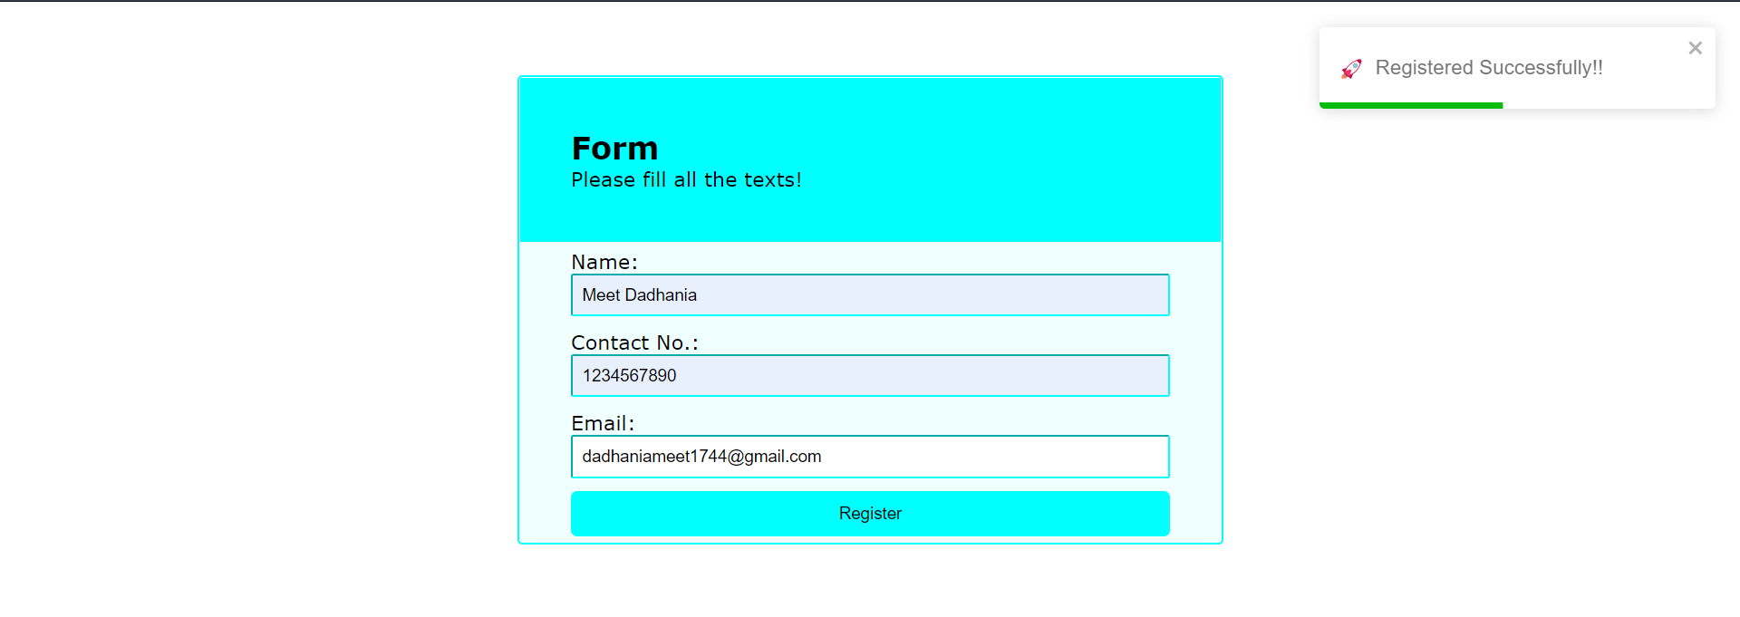
Demonstration With success message

Slide 5
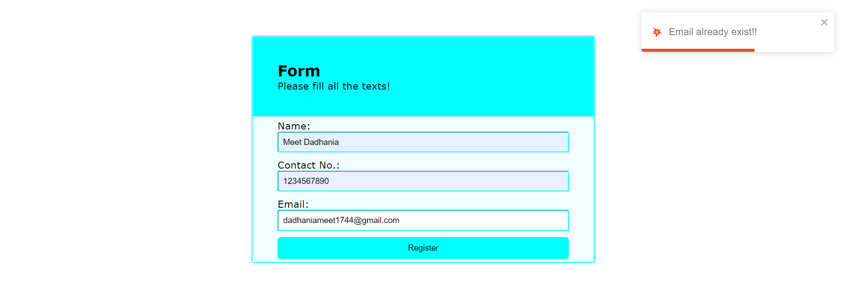
Demonstration With error message

Slide 6

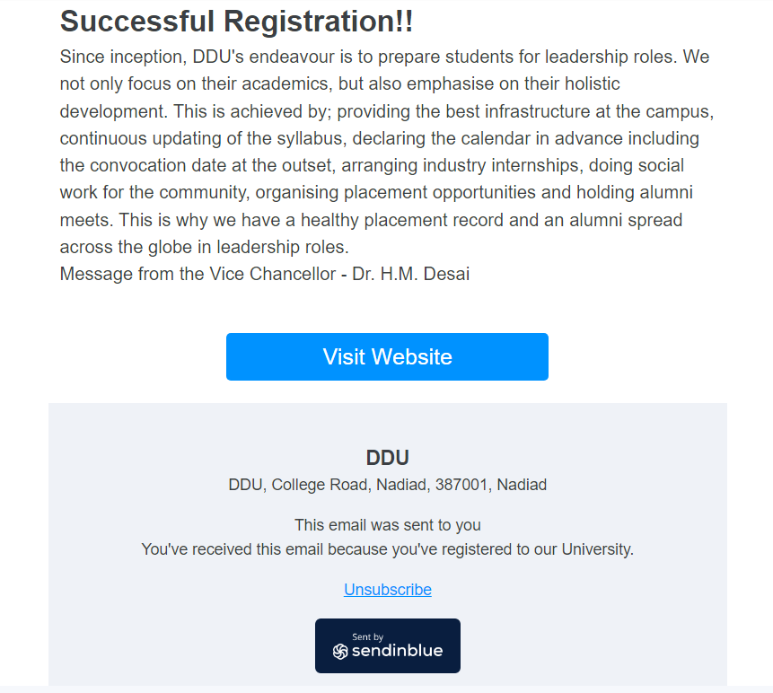
Email example

Slide 7
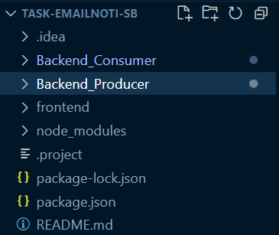
File Structure

Slide 8
Frontend Libraries:
Toastify [ Pop up messages ]
npm install –save react-toastify
Aixos [ Sending Http request ]
npm install axios

Slide 9
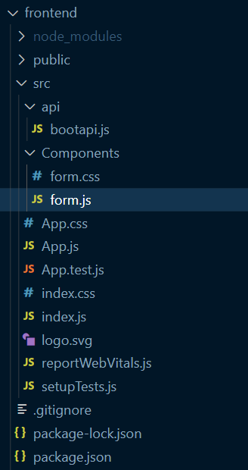
Frontend File Structure

Slide 10
App.js
import './App.css';
import Displayform from './Components/form';
const App = () => {
return(
<>
<Displayform />
</>
)
}
export default App;

Slide 11
Components/form.js
import React from "react";
import {useEffect,useState } from "react";
import './form.css';
import baseurl from "../api/bootapi";
import axios from "axios";
import {ToastContainer,toast} from 'react-toastify';
const Displayform =()=>{
useEffect(()=>{
console.log("hello")
}, []);
const [student,setStudent] = useState({});
const handleForm=(e)=>{
console.log(student)
studentRegistered(student);
e.preventDefault();
}

Slide 12
Components/form.js
const studentRegistered=(data)=>{
const resolveWithSomeData = axios.post(`${baseurl}/studentdetails`,data); //Post request with toastify
toast.promise(
resolveWithSomeData,{
pending: {
render(){
return "Please Wait!!"
},
icon: "✋",
},
success: {
render({data}){
return `Registered Successfully!!`
},
// other options
icon: "🚀",
},
error: {
render({data}){
console.log(data);
// When the promise reject, data will contains the error
if(data.message==="Request failed with status code 500" || data.message==="Request failed with status code 406")
return `Email already exist!!`
return `Registration Failed!!`
},
icon:"💥",
}
}
)

Slide 13
Components/form.js
{
return(
<div>
<div class="box-1">
<div class="title_box">
<h2>Form</h2>
<p>Please fill all the texts!</p>
</div>
<div class="content_box">
<ToastContainer /> //Add ToastContainer where you need pop up message
<form onSubmit={handleForm}>
<p>
Name: <br />
<input type="text" name="Name" id="Name" placeholder="Type your full name here" required onChange={(e)=>{
setStudent({...student,studentName:e.target.value})
}}/>
</p>
<p>
Contact No.: <br />
<input type="tel" name="mobile" id="mobile" placeholder="Contact No." required onChange={(e)=>{
setStudent({...student,studentContactNumber:e.target.value})
}}/>
</p>
<p>
Email: <br />
<input type="email" placeholder="Type your email here" required onChange={(e)=>{
setStudent({...student,studentEmail:e.target.value})
}}/>
</p>
<input type="submit" value="Register" />
</form>
</div>
</div>
</div>
)
}
}
}
export default Displayform;

Slide 14
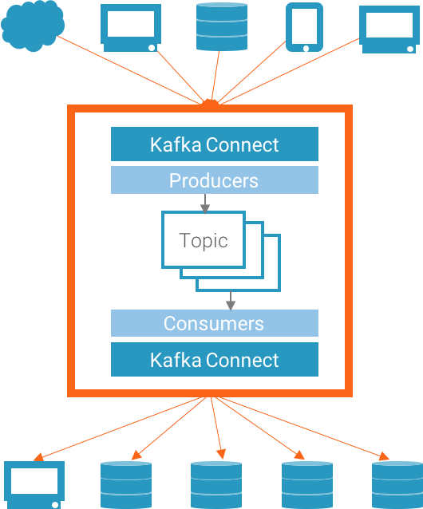
Apache Kafka

Slide 15
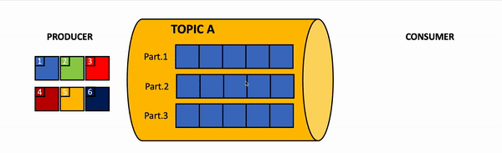
Topic has partitions

Slide 16
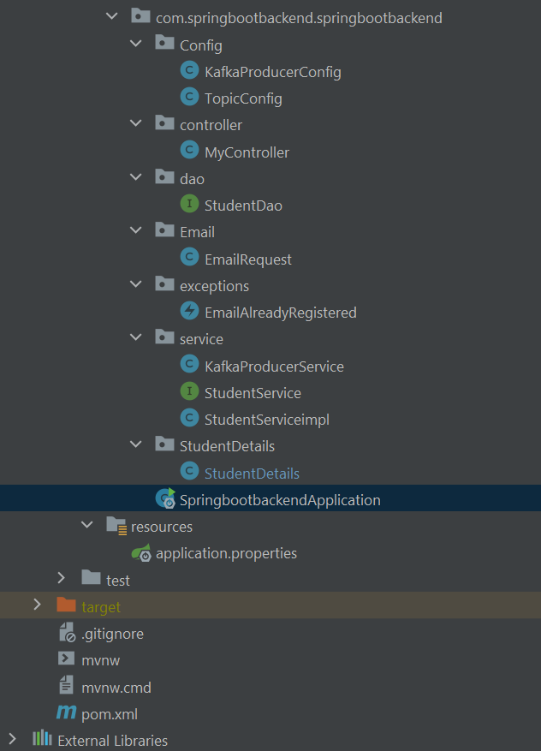
Producer Server File Structure

Slide 17
SpringbootbackendApplication.java
@SpringBootApplication public class SpringbootbackendApplication { public static void main(String[] args) { SpringApplication.run(SpringbootbackendApplication.class, args); } }

Slide 18
Controller/MyController.java
@RestController @CrossOrigin("http://localhost:3000") public class MyController { @Autowired private StudentService studentService; /** * Endpoint for adding new student details. It takes in a StudentDetails object as a request body and checks if the email already exists in the database. If it exists, it returns a response with a message "Email is already in use" and a status code of NOT_ACCEPTABLE. If not, it adds the student details and returns a response with the added student details and a status code of CREATED. This endpoint throws an exception EmailAlreadyRegistered if the email is already in use. */ @PostMapping("/studentdetails") public ResponseEntity<Object> addStudent(@RequestBody StudentDetails student) throws EmailAlreadyRegistered{ if (studentService.emailExists(student.getStudentEmail())) { return new ResponseEntity<>("Email is already in use",HttpStatus.NOT_ACCEPTABLE); } return new ResponseEntity<>(studentService.addStudent(student),HttpStatus.CREATED); }

Slide 19
Service/StudentServiceImpl.java
@Autowired private StudentDao studentDao; @Autowired private KafkaProducerService producer; /**This method is used to add a new student to the database. * It takes in a StudentDetails object as a parameter and saves it to the database using the studentDao object. * After saving, it creates an EmailRequest object, sets the subject, to email and body of the email, and sends the email using the producer.sendEmailRequest method. * If there is an exception of JsonProcessingException, it throws a runtime exception with the exception message. * It returns null.*/ @Override public StudentDetails addStudent(StudentDetails student){ try { studentDao.save(student); EmailRequest email=new EmailRequest(); email.setTo(student.getStudentEmail()); email.setName(student.getStudentName()); producer.sendEmailRequest(email); System.out.println("Entry successfull"); } catch (JsonProcessingException e) { throw new RuntimeException(e); } return null; }

Slide 20
Database Configuration
Dependencies:
<dependency> <groupId>mysql</groupId> <artifactId>mysql-connector-java</artifactId> </dependency>
<dependency> <groupId>com.mysql</groupId> <artifactId>mysql-connector-j</artifactId> <scope>runtime</scope> </dependency>

Slide 21
Database Configuration
Properties:
spring.jpa.hibernate.ddl-auto=update spring.datasource.url=jdbc:mysql://sql6.freesqldatabase.com:3306/sql6590157 spring.datasource.username=sql6590157 spring.datasource.password= spring.datasource.driver-class-name=com.mysql.cj.jdbc.Driver hibernate.dialect=org.hibernate.dialect.MySQL5InnoDBDialect spring.jpa.show-sql = true

Slide 22
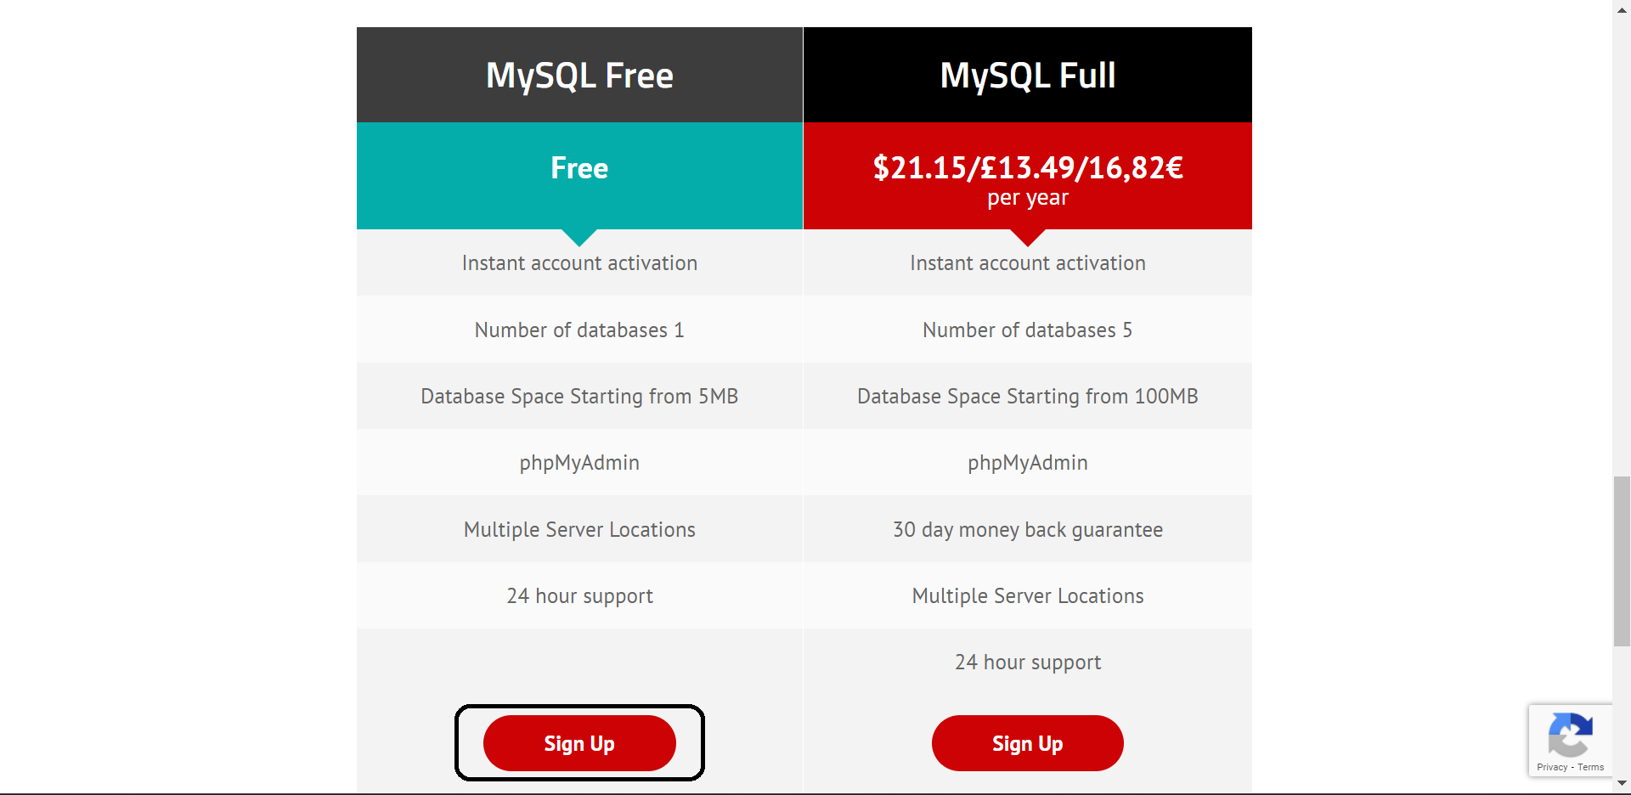
Freesqldatabase Setup

Slide 23
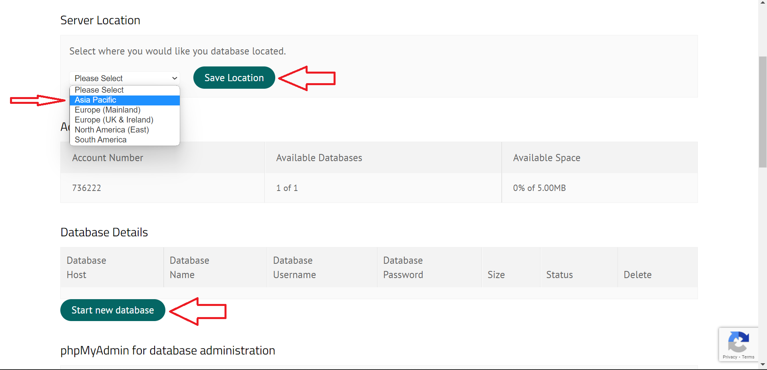

Slide 24
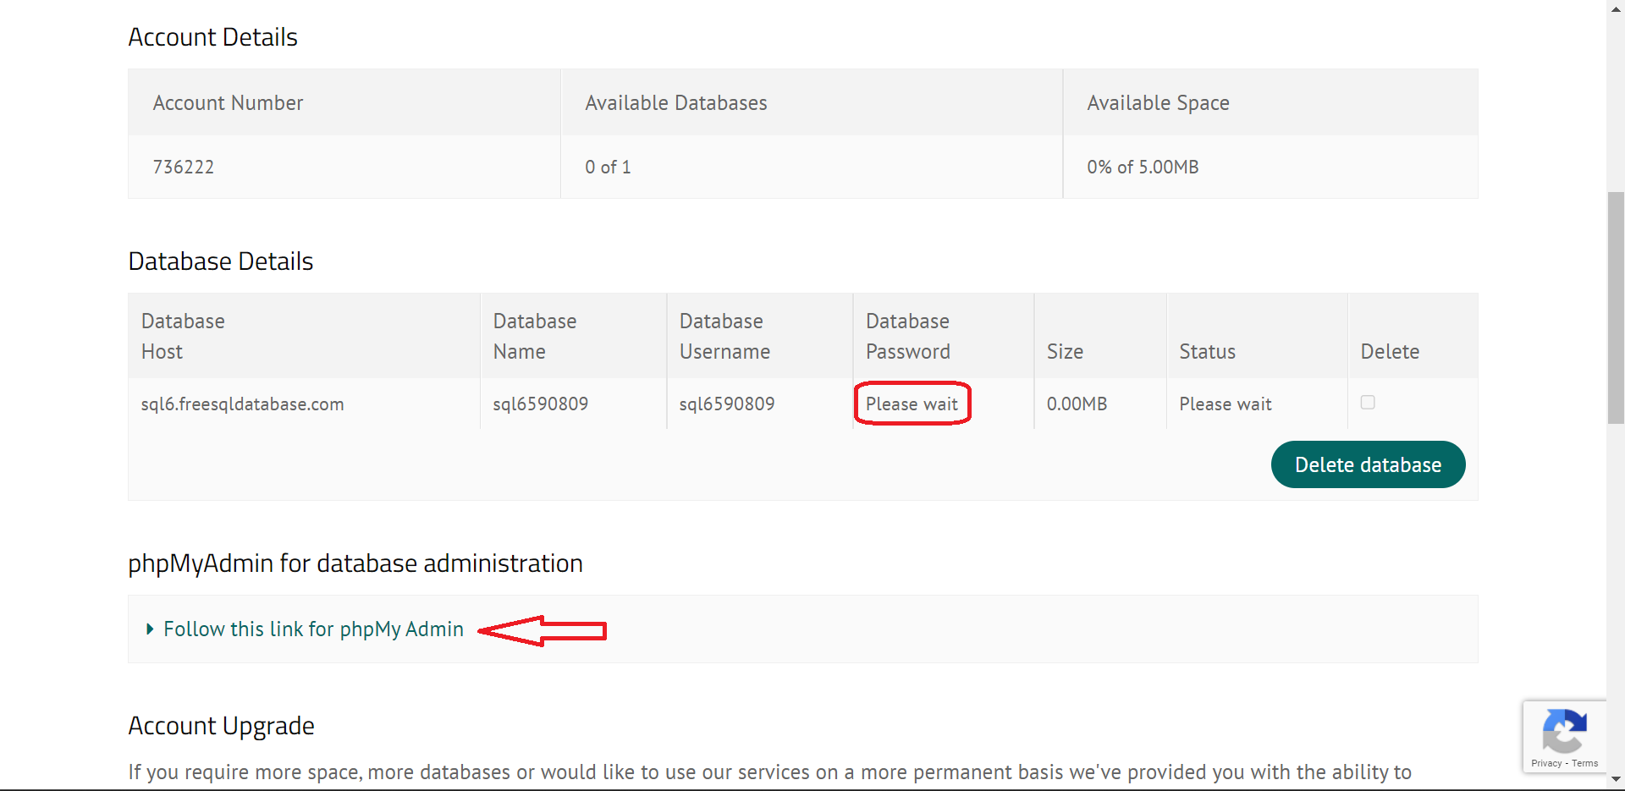

Slide 25
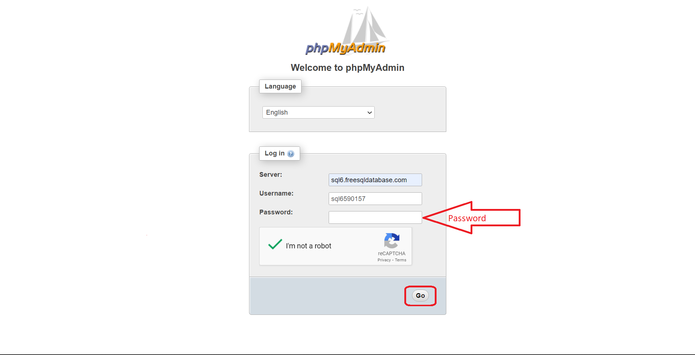

Slide 26
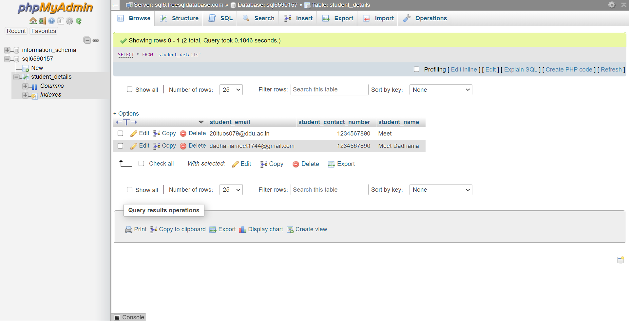

Slide 27
StudentDetails/StudentDetails.java
@Entity @Table(name = "student_details") //Creates Table in database public class StudentDetails { // TODO Auto-generated method stub //Primary Key Annotation @Id @Column(name="student_email") private String studentEmail; @Column(name="student_name") private String studentName; @Column(name="student_contact_number") private long studentContactNumber;

Slide 28
StudentDao.java
/** * StudentDao interface for handling database operations * for StudentDetails entity */ @Repository public interface StudentDao extends JpaRepository<StudentDetails, String>{ /** * Custom query to fetch a student by their email */ @Query("SELECT u FROM StudentDetails u WHERE u.studentEmail = :studentEmail") StudentDetails findByEmail(@Param("studentEmail") String studentEmail); }

Slide 29
Kafka Configuration Producer and Consumer sides
Dependencies:
<dependency> <groupId>org.springframework.kafka</groupId> <artifactId>spring-kafka</artifactId> </dependency>
<dependency> <groupId>org.apache.kafka</groupId> <artifactId>kafka-clients</artifactId> <version>3.3.1</version> </dependency>

Slide 30
Kafka Configuration Producer and Consumer sides
#Properties of Kafka spring.kafka.producer.key-serializer=org.apache.kafka.common.serialization.StringSerializer spring.kafka.producer.value-serializer=org.apache.kafka.common.serialization.StringSerializer spring.kafka.consumer.group-id=myGroup spring.kafka.consumer.auto-offset-reset=earliest spring.kafka.topic.name=student-registration

Slide 31
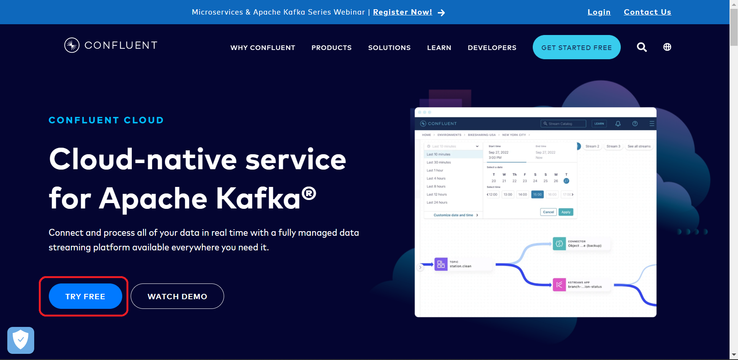
Confluent Cloud Setup

Slide 32
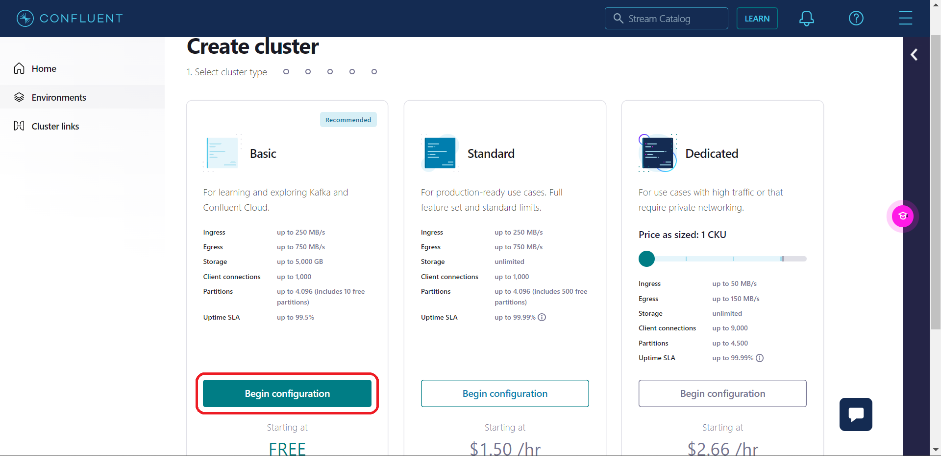

Slide 33
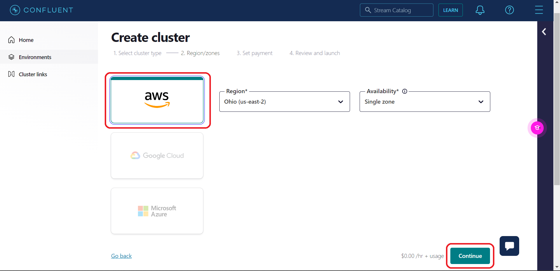

Slide 34
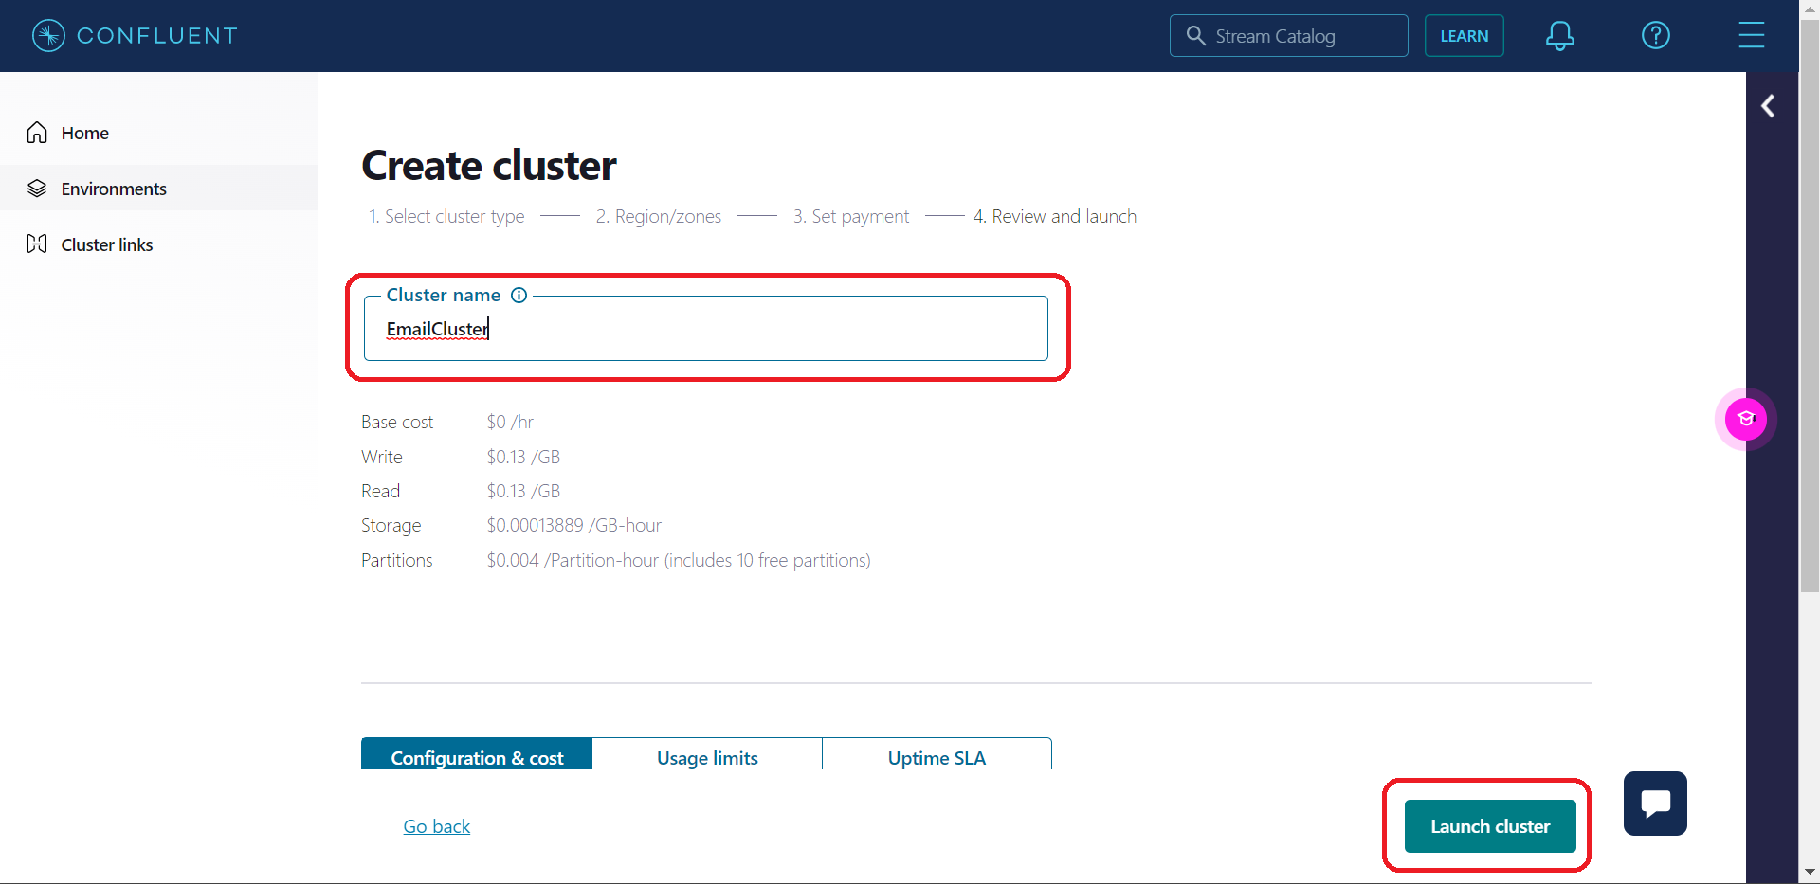

Slide 35
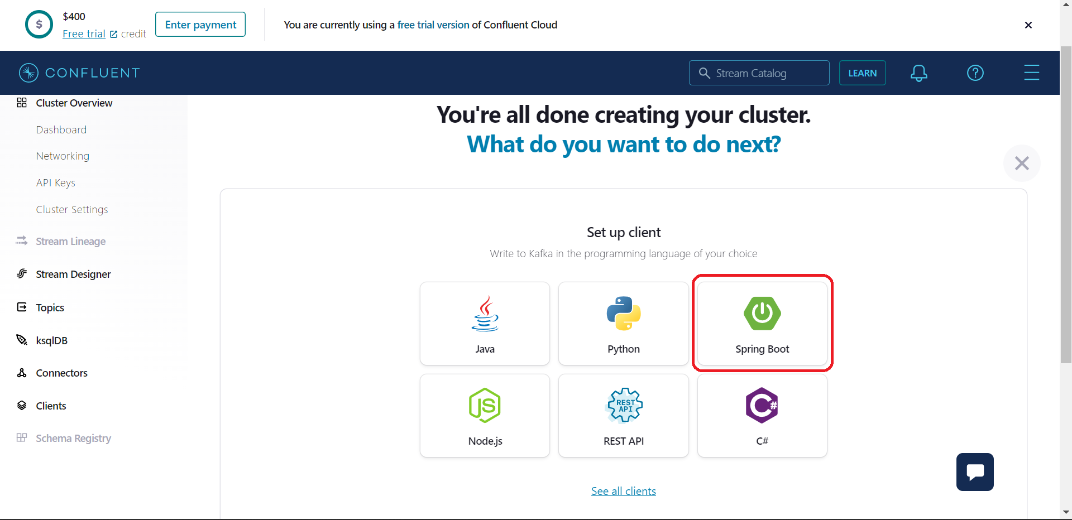

Slide 36
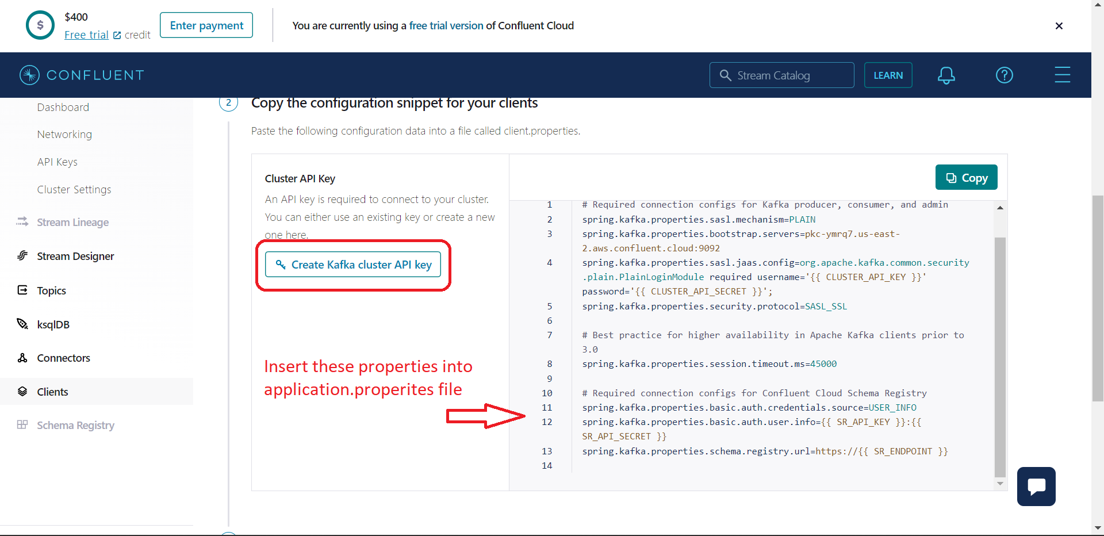

Slide 37
Config/TopicConfig.java Producer and Consumer sides
@Configuration public class TopicConfig { @Value("${spring.kafka.topic.name}") private String topicName; /** * This method is used for creating a bean of NewTopic with the name set from application properties. */ @Bean public NewTopic MyTopic(){ return TopicBuilder.name(topicName) .build(); } }

Slide 38
Config/ProducerConfig.java
/** inject the value of topic name from application.properties*/ @Value("${spring.kafka.topic.name}") private String kafkaService; /** * This method is used for creating a map of configuration properties for Kafka producer. */ public Map<String,Object> producerConfig(){ HashMap<String,Object> config=new HashMap<>(); /** set the bootstrap server and serializer classes */ config.put(ProducerConfig.BOOTSTRAP_SERVERS_CONFIG, kafkaService); config.put(ProducerConfig.KEY_SERIALIZER_CLASS_CONFIG, StringSerializer.class); config.put(ProducerConfig.VALUE_SERIALIZER_CLASS_CONFIG, StringSerializer.class); return config; } /** * This method is used for creating a bean of ProducerFactory for sending messages of type String and StudentDetails. */ @Bean public ProducerFactory<String,StudentDetails> producerFactory(){ return new DefaultKafkaProducerFactory<>(producerConfig()); } /** * This method is used for creating a bean of KafkaTemplate for sending messages to a topic. */ @Bean public KafkaTemplate<String, StudentDetails> kafkaTemplate(ProducerFactory<String,StudentDetails> producerFactory){ return new KafkaTemplate<>(producerFactory); }

Slide 39
Service/KafkaProducerService.java
@Service public class KafkaProducerService { private final KafkaTemplate<String, String> kafkaTemplate; @Value("${spring.kafka.topic.name}") private String emailRequestsTopic; public KafkaProducerService(KafkaTemplate<String, String> kafkaTemplate) { this.kafkaTemplate = kafkaTemplate; } public void sendEmailRequest(EmailRequest emailRequest) throws JsonProcessingException { // Serialize the email request as a JSON string ObjectMapper objectMapper = new ObjectMapper(); String requestJson = objectMapper.writeValueAsString(emailRequest); // Send the email request to the Kafka topic kafkaTemplate.send(emailRequestsTopic, requestJson); System.out.println("In producer service"); } }

Slide 40
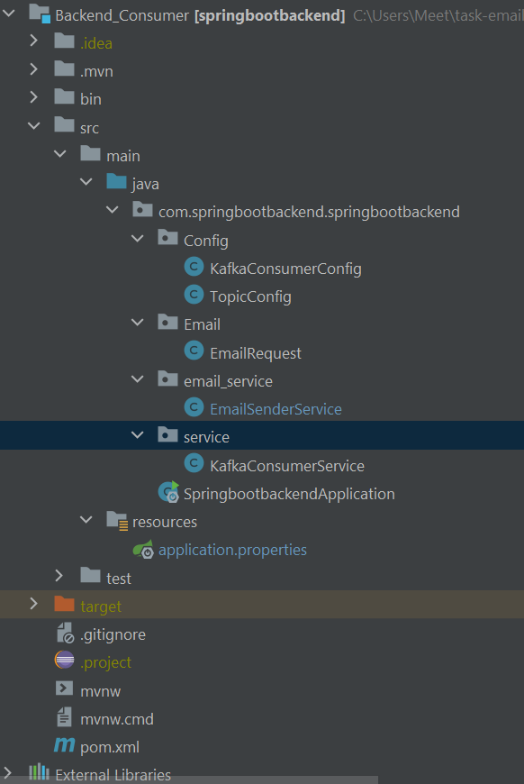
Consumer Server File Structure

Slide 41
Config/ConsumerConfig.java
public class KafkaConsumerConfig { @Value("${spring.kafka.topic.name}") private String kafkaService; public Map<String,Object> consumerConfig(){ HashMap<String,Object> config=new HashMap<>(); config.put(ConsumerConfig.BOOTSTRAP_SERVERS_CONFIG, kafkaService); config.put(ConsumerConfig.KEY_DESERIALIZER_CLASS_CONFIG, StringSerializer.class); config.put(ConsumerConfig.VALUE_DESERIALIZER_CLASS_CONFIG, StringSerializer.class); return config; } @Bean public ConsumerFactory<String,String> consumerFactory(){ return new DefaultKafkaConsumerFactory<>(consumerConfig()); } @Bean public KafkaListenerContainerFactory<ConcurrentMessageListenerContainer<String,String>> factory (ConsumerFactory<String,String> consumerFactory){ ConcurrentKafkaListenerContainerFactory<String,String> factory = new ConcurrentKafkaListenerContainerFactory<>(); factory.setConsumerFactory(consumerFactory); return factory; } }

Slide 42
Service/KafkaConsumerService.java
@Service public class KafkaConsumerService { @Autowired private EmailSenderService emailService; @KafkaListener(id = "myGroup",topics = "${spring.kafka.topic.name}") public void processEmailRequest(String requestJson) throws JsonProcessingException { System.out.println("In ConsumerService"); // Deserialize the email request data from the JSON string ObjectMapper objectMapper = new ObjectMapper(); EmailRequest emailRequest = objectMapper.readValue(requestJson, EmailRequest.class); // Extract the necessary information from the email request String to = emailRequest.getTo(); String name = emailRequest.getName(); //Mail Sending Method emailService.sendInBlue(to,name); } }

Slide 43
Sendinblue Configuration
Dependencies:
<dependency> <groupId>com.sendinblue</groupId> <artifactId>sib-api-v3-sdk</artifactId> <version>6.0.0</version> <scope>compile</scope> </dependency>
<repositories> <repository> <id>sendinblue</id> <url>https://maven.sendinblue.com/repositories/releases</url> </repository> </repositories>

Slide 44
Sendinblue Configuration
Properties:
#Properties of email sendinblue.apiKey= #Api-Key sendinblue.id=2

Slide 45
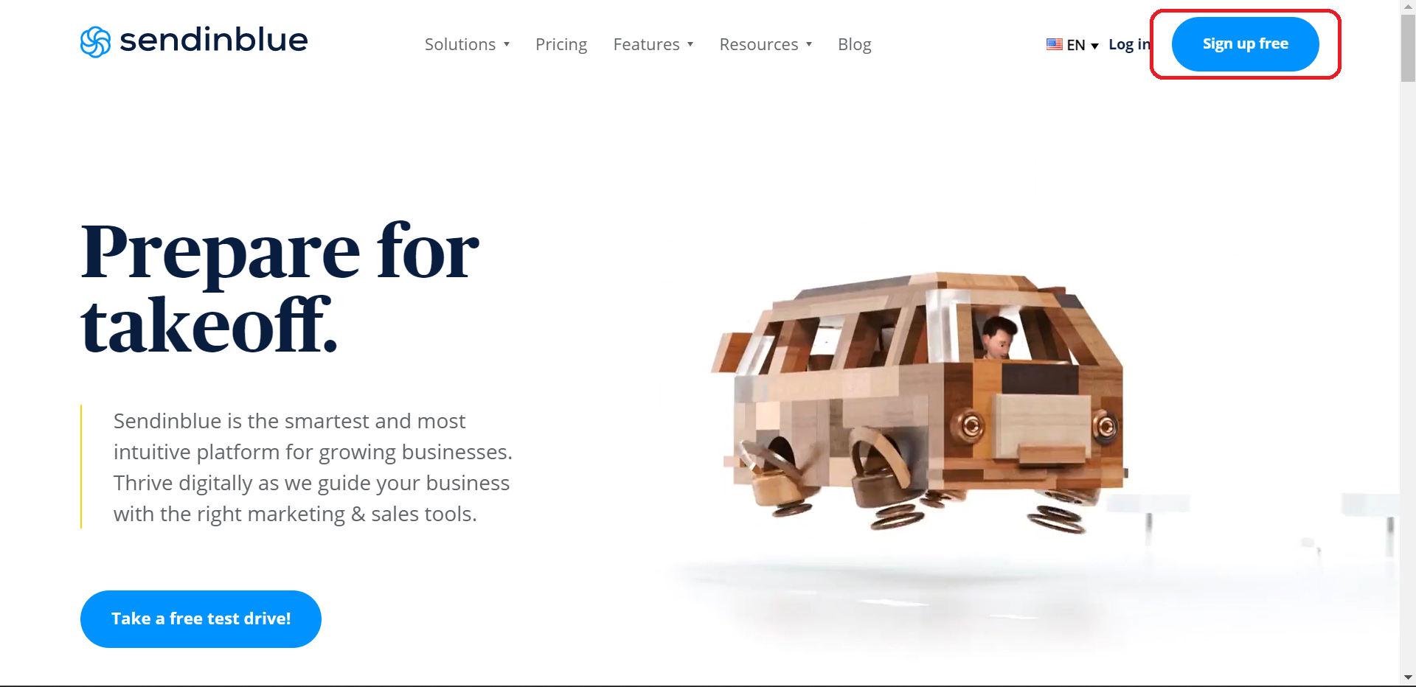
Sendinblue Setup

Slide 46
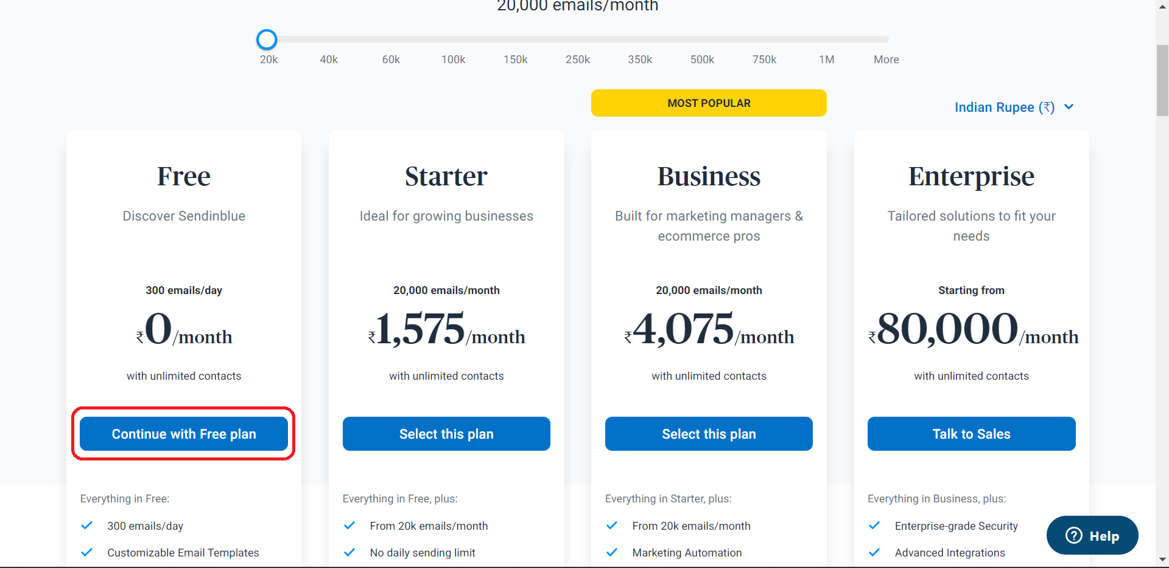

Slide 47
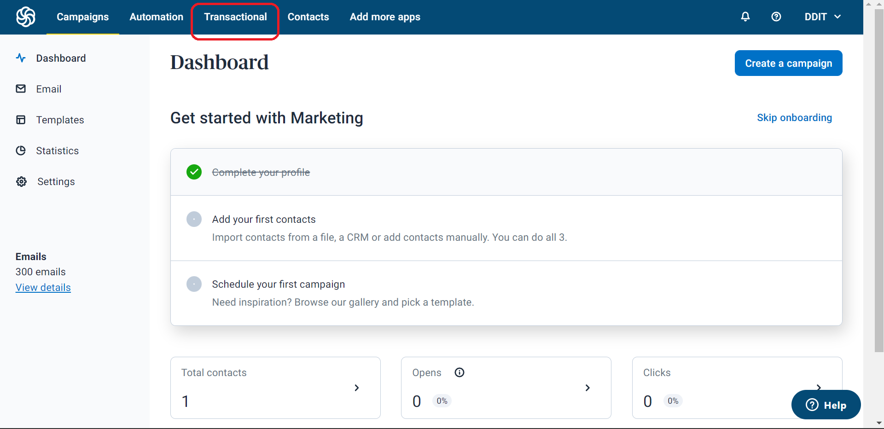

Slide 48
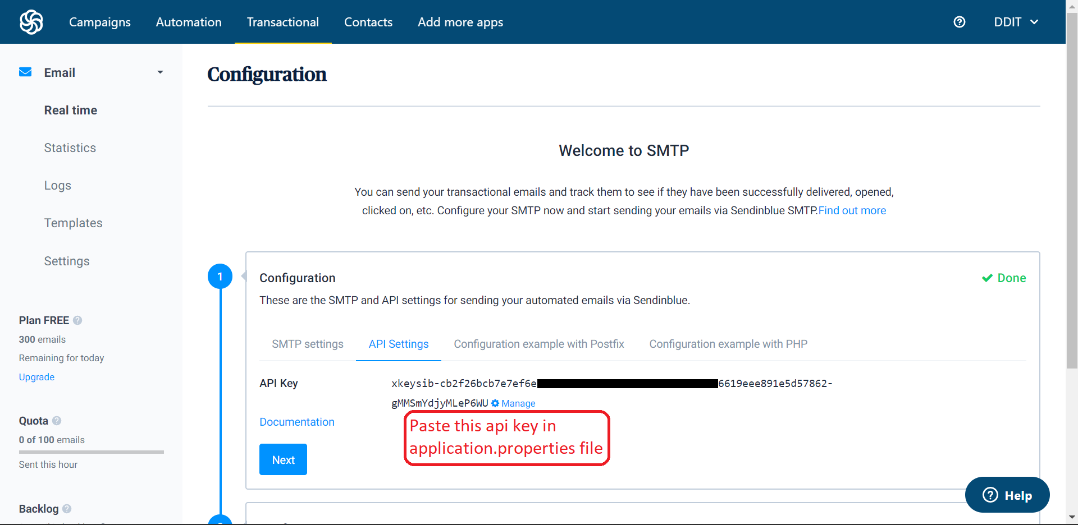

Slide 49
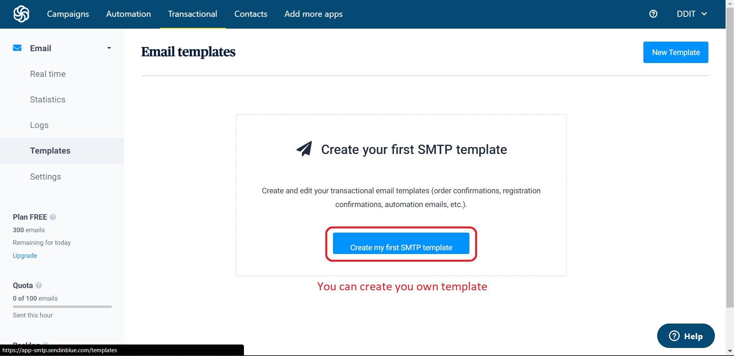

Slide 50
email_service/EmailSenderService.java
@Service public class EmailSenderService { @Value("${sendinblue.apiKey}") private String apiKey; @Value("${sendinblue.id}") private String id; public void sendInBlue(String to,String name){ try { // Creating a map to hold the email parameters Map<String, Object> params = new HashMap<>(); params.put("id", id); params.put("to", to); params.put("subject","Successful Registration!!"); params.put("params", new HashMap<String, Object>() {{ put("NAME", name); }}); // Creating an ApiClient object ApiClient apiClient = new ApiClient(); apiClient.setApiKey(apiKey); TransactionalEmailsApi emailApi = new TransactionalEmailsApi(apiClient); SendSmtpEmail smtpEmail = new SendSmtpEmail(); smtpEmail.setTo(Collections.singletonList(new SendSmtpEmailTo().email(to))); smtpEmail.setTemplateId(Long.valueOf(id)); smtpEmail.setParams(params); emailApi.sendTransacEmail(smtpEmail); System.out.println("MailSent"); } catch (ApiException e) { System.out.println(e); } catch (sendinblue.ApiException e) { throw new RuntimeException(e); } } }

Slide 51
Useful Links
Source Code
Confluent
Sendinblue
Freesqldatabase

Slide 52
Developed By
IT024 – Meet Dadhania
IT025 – Manushi Dagli

